Slide 1
Sound and Vision for Interactivity
Outcome 1
Describe and compare file formats and their associated digital encoding formats for audio and visual content

Slide 2
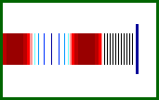
What is sound?
Sound is a continuous wave that travels through the air
It will not travel through a vacuum.
The wave is made up of pressure differences.
Sound is detected by measuring the pressure level at a location

Slide 3
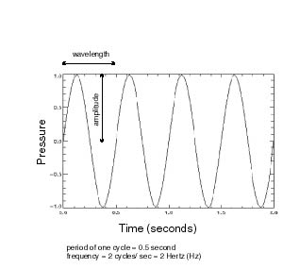
What is sound?
Sound is a wave phenomenon like light
Sound waves have normal wave properties:
  Reflection- sound wave reflecting off a surface
  Refraction - is the bending of waves when they enter a medium
  Diffraction- uses the edges of a barrier as a secondary sound source that sends waves in a new direction

Slide 4
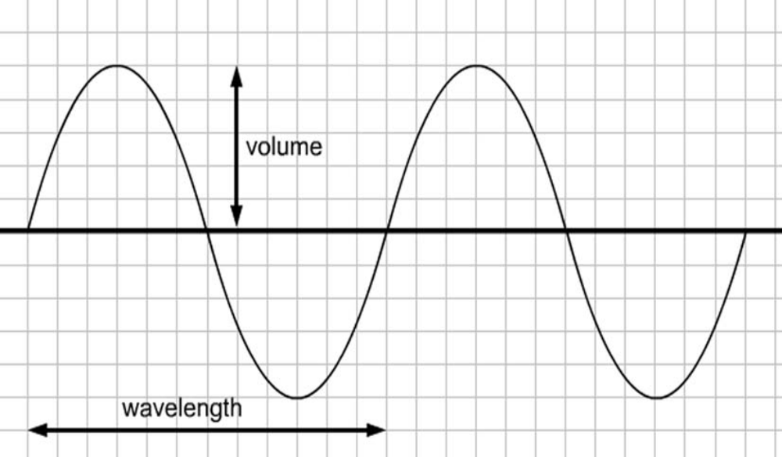
Sound wave properties
(Amplitude)
The Sine Wave

Slide 5
Sound wave properties
The length of one complete wave is called the wavelength, and the number of completed waves that pass a fixed point in a fixed unit of time is the frequency of the wave
Amplitude - The measure of how powerful sound waves are in terms of pressure

Slide 6
Sound wave properties
Pitch
  attribute of auditory sensation in terms of which sounds may be ordered on a scale extending from low to high
  approximately pitch it is proportional to the to frequency

Slide 7
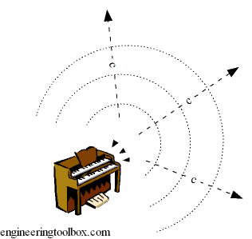
Speed of Sound
Depends on the material of the vibrating medium
Sound can vibrate water, wood (speaker enclosures, pianos), metal, plastic, etc.
Sound speed in dry air is 330 meters/second at 0º C
Faster in warm air, slower in cold

Slide 8
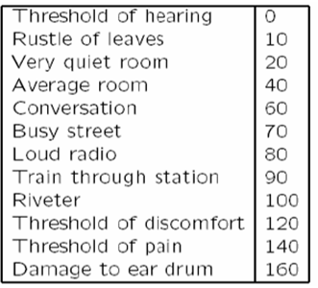
Signal to Noise Ratio (SNR)
The usual levels of sound we hear around us are described in terms of decibels (dB), as a ratio to the quietest sound we are capable of hearing

Slide 9
Why Digitize?
Microphones, video cameras produce analog signals
To store audio or video data into a computer, we must digitize it by converting it into a stream of numbers
Digitization means conversion to a stream of numbers, and preferably these numbers should be integers for efficiency.

Slide 10

Analog vs Digital Signals
A continuously recorded sine wave signal usually recorded on a magnetic medium

Slide 11
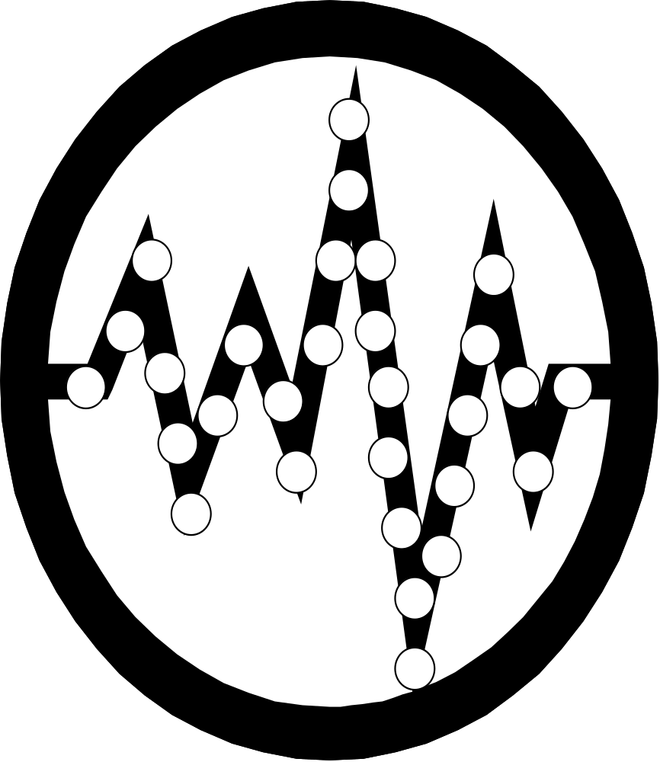
Analog vs Digital Signals
A waveform that switches between two voltage levels representing the two states of a Boolean value (0 and 1)

Slide 12
Digitisation
Building digital libraries begins with creating digital content and collections
Digital content may be created in the following two ways-
  Born digital
  Digitisation

Slide 13
What is Digitisation?
Creating a digital object by converting a source object in analog form
What is a digital object?
  Digital objects are individual entities in
A digital collection
  Any object which can be digitised can be a digital object

Slide 14
Digitisation Process
Identification of the items for the collection
Selection of the ‘kind’ of content
Choice of formats
Choice of hardware
Choice of software
Selection of medium
Storage and archiving
Management

Slide 15
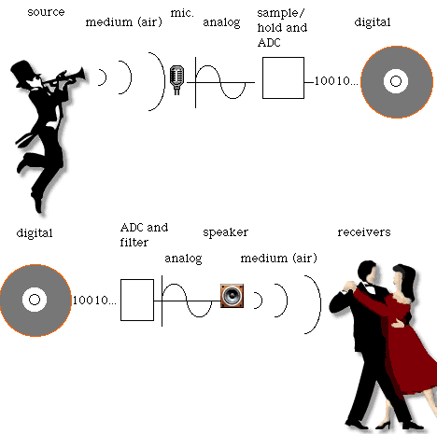
Digitisation

Slide 16
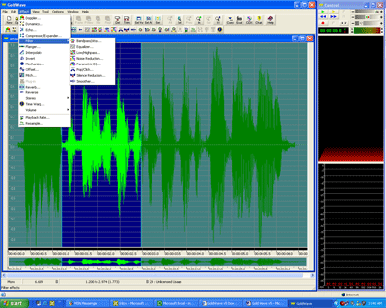
Digitization
For recording: need to convert the audio signal from analog to digital (A/D or ADC)
For playback: need to convert the audio signal from digital to analog (D/A or DAC)

Slide 17
The Advantages of Digital Audio
Good quality
It can be copied without loss of quality
Can edit the sound in various ways:
  to remove coughing from live recording
  to speed up or slow down the speed of the music
Can compress the data, e.g. by removing non-audible sounds
Digital circuitry more immune to aging and temperature problems

Slide 18
The disadvantages of Digital Signals
Can be expensive
Require knowledge of computers
Some of the software not widely used
Most of the software not readily available

Slide 19
Sampling- Digital Signals Revisited
Digital Signal – a signal that samples specified portions of a signal resulting in discrete digital information (i.e. bits of data)
Sampled discrete data

Slide 20
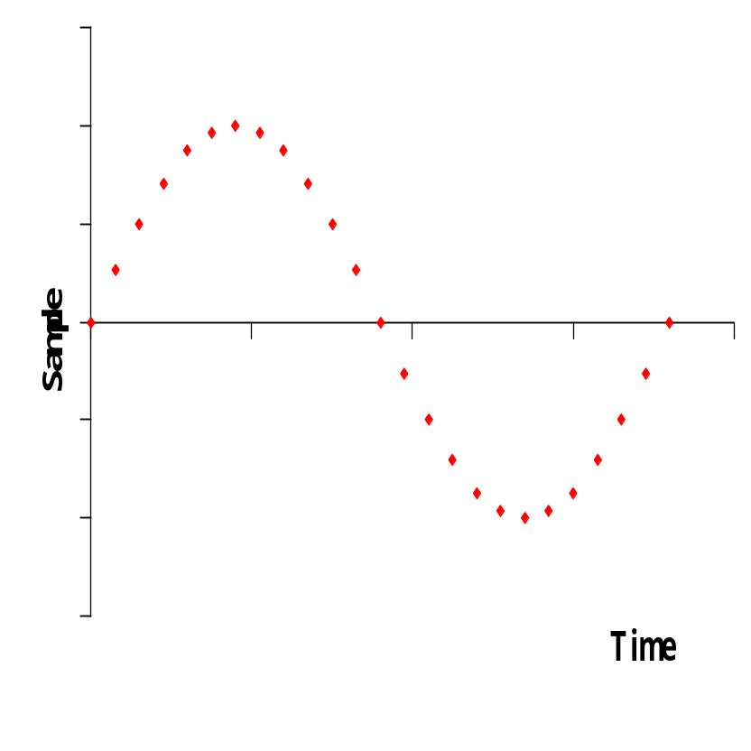
What is sampling?
A sample is a measurement of the pressure at a point in time
In sampling the signal is measured in a series of instants
Sampling is used to digitize analog sound waves

Slide 21
Sampling Rate
Sampling rate defines the number of samples per second taken from an analog signal to make a digital signal
Sampling rate determines the sound frequency range which can be represented in the digital waveform
  High sampling rate preserves sound quality
  Low sampling rate saves disk space but reduces quality sound

Slide 22
Sampling Rate for Sound
1000 samples per second is called a kilohertz (KHz)
8000 samples per second captures the essential characteristics of the human voice.
  This is the standard for telephone transmission.
44,100 samples per second captures CD quality sound
DVD uses a sampling rate of up to 192,000 samples per second

Slide 23
Sampling Error for Sound
In order to reconstruct the original analog signal without loss we obviously need a minimum sampling frequency
Nyquist Theorem – You need to sample sound at least twice the frequency of the highest frequency component
With this sampling rate, you can reconstruct the original sound with fidelity

Slide 24
The Nyquist Theorem
For noise-free channels the sampling frequency f_{A} must be twice as high as the highest freqency occurring in the signal
f_{A}=2f_{S}

Slide 25
Bit Depth
Bit depth describes the number of bits per sample
Bit depth directly corresponds to the resolution of each sample in a set of digital audio data
Common sampling includes:
  8 bit depth (in CDs)
  16 bit depth (in DVDs)

Slide 26
Digital Audio Quality
For a given sound wave, the quality of the digitized sound data is determined by
  the sampling rate
  the number of bits per sample

Slide 27

Sampling Example
A 400 Hz wave sampled at 44.1 MHz.
Result - This sampling rate will reproduce a sound with high fidelity.
That means that the digitized sound will sound nearly exactly like the original to the human ear.

Slide 28

Sampling Example
A 400 Hz wave sampled at 400 Hz becomes a flat wave.
Result - No sound!

Slide 29

Sampling Example
A 400 Hz wave sampled at 600 Hz.
Result - The digitized wave will not sound like the original.

Slide 30
Audio Channels
Audio channel is a means for delivering audio signals from one point to another
Audio stereo means sound which is divided into two separate channels
These two channels are played back simultaneously via separate speakers
Mono or monophonic describes a system where all the audio signals are mixed together and routed through a single audio channel

Slide 31
Audio Sampling Variables
File Size
Quality
Digital Audio

Slide 32
Audio Sampling Variables
Sample Rate
Bit Depth
Number of Channels
Record
Settings
Sound
Quality
Balance
File
Size

Slide 33
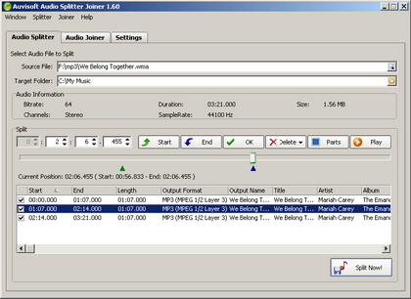
Audio File Size
Audio file size is determined by a combination of:
  Sample rate
  Bit depth
  Number of channels
  Length in minutes

Slide 34
Audio File Size
CD characteristics…
- Sampling rate:
44,100 samples per second (44.1 kHz)
- Sample word length:
16 bits (i.e., 2 bytes) per sample
- Number of channels:
2 (stereo)
How big is a 5-minute CD-quality sound file?

Slide 35
Audio File Size
How big is a 5-minute CD-quality sound file?
44,100 samples * 2 bytes per sample * 2 channels
= 176,400 bytes per second
5 minutes * 60 seconds per minute
= 300 seconds
300 seconds * 176,400 bytes per second
= 52,920,000 bytes = c. 50.5 megabytes (MB)

Slide 36
Audio Compression
Audio signal – overview
  Sampling rate (# of samples per second)
  Bit rate (# of bits per second). Typically, uncompressed stereo 16-bit 44.1KHz signal has a 1.4MBps bit rate
  Number of channels (mono / stereo / multichannel)
Reduction by lowering those values or by data compression / encoding

Slide 37
Audio Compression
Redundant information
  Implicit in the remaining information
  Ex. oversampled audio signal
Irrelevant information
  Perceptually insignificant
  Cannot be recovered from remaining information

Slide 38
Audio Compression
Lossless Audio Compression
  Removes redundant data
  Resulting signal is same as original – perfect reconstruction
Lossy Audio Encoding
  Removes irrelevant data
  Resulting signal is similar to original

Slide 39
Audio Compression
Audio vs. Speech Compression Techniques
  Speech Compression uses a human vocal tract model to compress signals
  Audio Compression does not use this technique due to larger variety of possible signal variations

Slide 40
Audio Artefacts
Lossy compression can leave ‘artefacts’
Symptoms:
❍ ringing or hissing sounds
❍ sounds like it was recorded underwater
❍ distortion of unpredictable sounds.
http://en.wikipedia.org/wiki/Compression_artifact

Slide 41
Digital audio formats

Slide 42
MPEG Audio Compression
Physically Lossy compression algorithm
Perceptually lossless, transparent algorithm
Exploits perceptual properties of human ear
Psychoacoustic modeling
MPEG Audio Standard ensures inter-operability, defines coded bit stream syntax, defines decoding process and guarantees decoder’s accuracy.

Slide 43
MPEG Audio Compression
No assumptions about the nature of the audio source
Exploitation of human auditory system perceptual limitations
Removal of perceptually irrelevant parts of audio signal
It offers a sampling rate of 32, 44.1 and 48 kHz

Slide 44
Audio Files
There are two main types of audio files on a computer:
  Pulse Code Modulation - where each number in the digital audio file represents exactly one sample in the waveform
    The basic techniques for creating digital signals from analog signals
  Compressed files- files which have been reduced in size

Slide 45
Audio File Formats
.wav
Standard audio file format used mainly in Windows PCs
Commonly used for storing uncompressed (PCM), CD-quality sound files, which means that they can be large in size - around 10MB per minute of music

Slide 46
Audio Files Format
.mp3
Compressed file
MP3 is the most popular format for downloading and storing music
MP3 uses a lossy compression algorithm
  designed to greatly reduce the amount of data required to represent audio recordings

Slide 47
Audio Files Format
.au
the standard audio file format used by Sun, Unix and Java
The audio in au files can be PCM or compressed

Slide 48
Audio Files Format
.aiff
the standard audio file format used by Apple
The audio data in a standard .aiff file are uncompressed
Like any non-compressed, lossless format, it uses much more disk space than MP3

Slide 49
Audio File Formats
.ra
Real Player format used for streaming audio files over the Internet

